Slide 1

Department of Computer Science & Engineering Artificial Intelligence & Machine Learning A.P. Shah Institute of Technology G. B. Road, Kasarvadavli, Thane(W), Mumbai - 400615 UNIVERSITY OF MUMBAI Academic Year 2023-2024

Slide 2
Computer Science & Engineering Artificial Intelligence and Machine Learning
By
Manasi Patil (22106042)
Aniruddha Pawar (22106009)
Yash Penkar (22106118)
Prarthana Patil (22106035)
Under the Guidance of
Prof. Ranjita Asati

Slide 3
AMPYtranslate

Slide 4
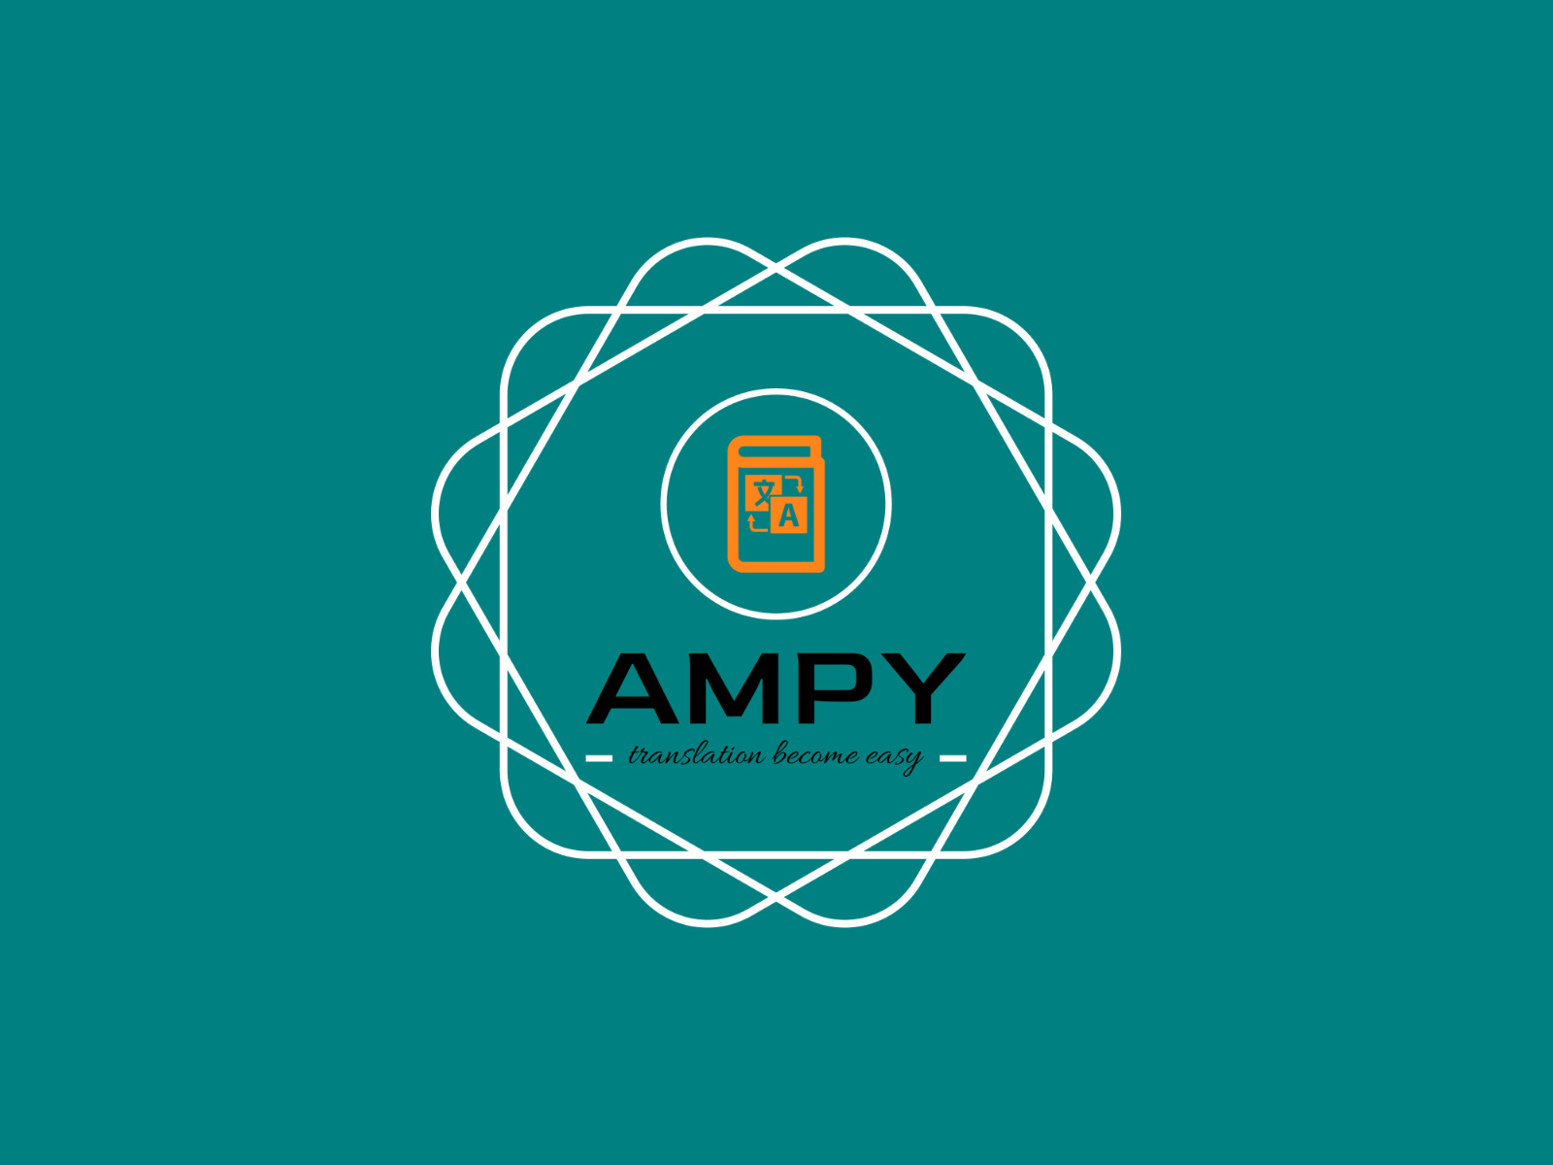

Slide 5
TABLE OF CONTENTS
Introduction
Objective
Block Diagram
Tools/Software, Language used
Implementation
Conclusion
References

Slide 6
INTRODUCTION
A voice-based language translator is an innovative tool that harnesses advanced speech recognition and machine translation technologies to bridge linguistic barriers in real-time. This versatile device or application listens to spoken words, accurately transcribes them, identifies the source language, and seamlessly translates the content into the desired target language, ensuring clear and effective communication between individuals who speak different languages. With the aid of text-to-speech capabilities, the translated message is then articulated aloud, providing a convenient and accessible means of cross-cultural communication and fostering global connectivity.

Slide 7
OBJECTIVE
The web application supports a wide variety of languages, for output, to cater to diverse user needs.
Accurate speech recognition technology for converting spoken words into text for translation.
Users will receive instant translations as they speak or shortly after, ensuring smooth and natural conversations.
Text to speech functionality converts translated text back into spoken words, making it easier for users to understand and communicate.
HAS an intuitive and user-friendly interface that is easy to navigate and understand.

Slide 8
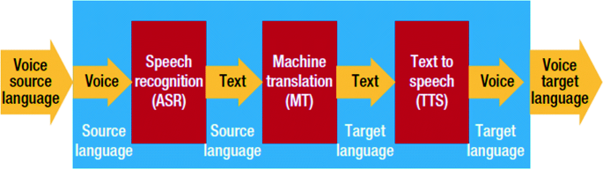
BLOCK DIAGRAM

Slide 9
LANGUAGES INCLUDED IN OUR APP
Hindi | Sanskrit | English
Marathi | Maithili | Dutch
Punjabi | Malayalam | French
Assamese | Meiteilon (Manipuri) | German
Bengali | Odia (Oriya) | Japnese
Gujarati | Mongolian | Hawaiian
Tamil | Chinese | Hebrew
Telugu | Spanish | Latin
Bhojpuri | Thai | Persian
Kannada | Vietnamese | Ukrainian
Our app translates English language into several other languages.
To translate into a particular language, user will have to input a shortcut key
The list of some languages included in our app is given:

Slide 10
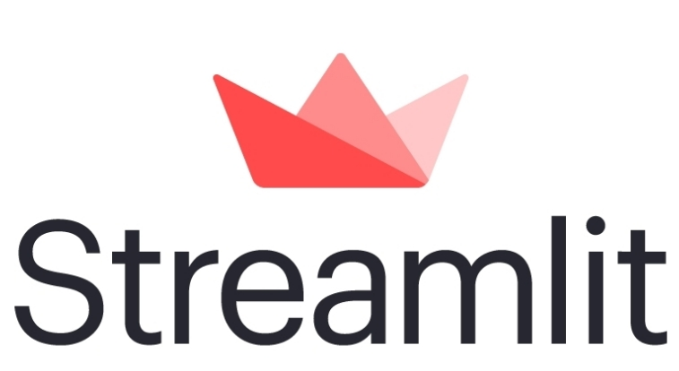

TOOLS/SOFTWARES, LANGUAGE USED

Slide 11
MODULES USED WHILE CODING
streamlit as st
speech_recognition as sr
from googletrans, Translator
from gtts, gTTS
from playsound, playsound

Slide 12
IMPLEMENTATION

Slide 13
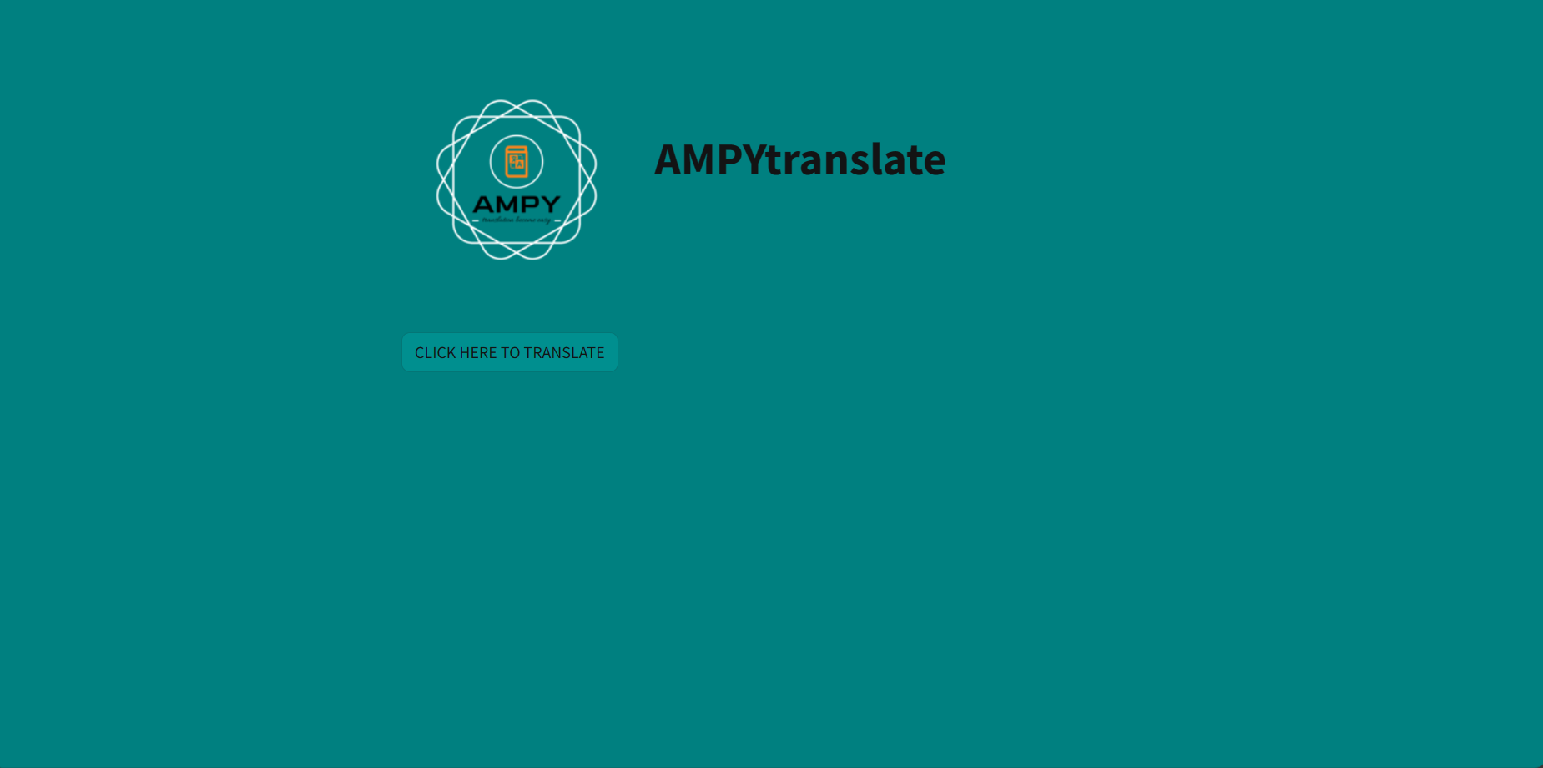

Slide 14
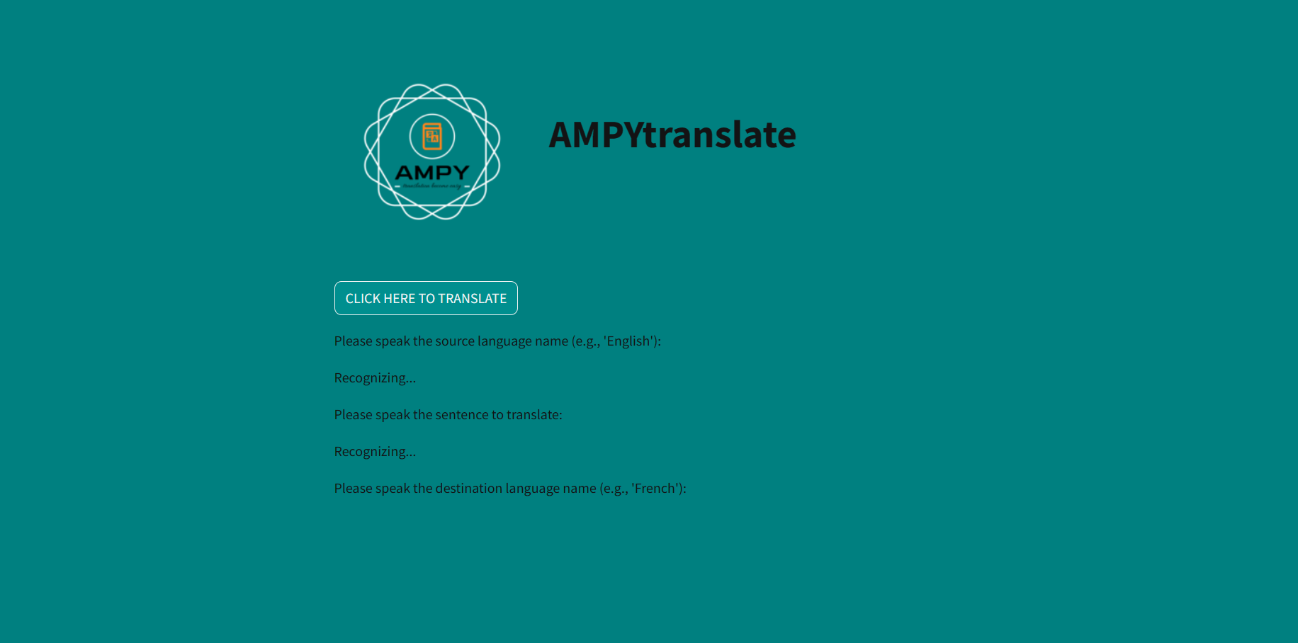

Slide 15
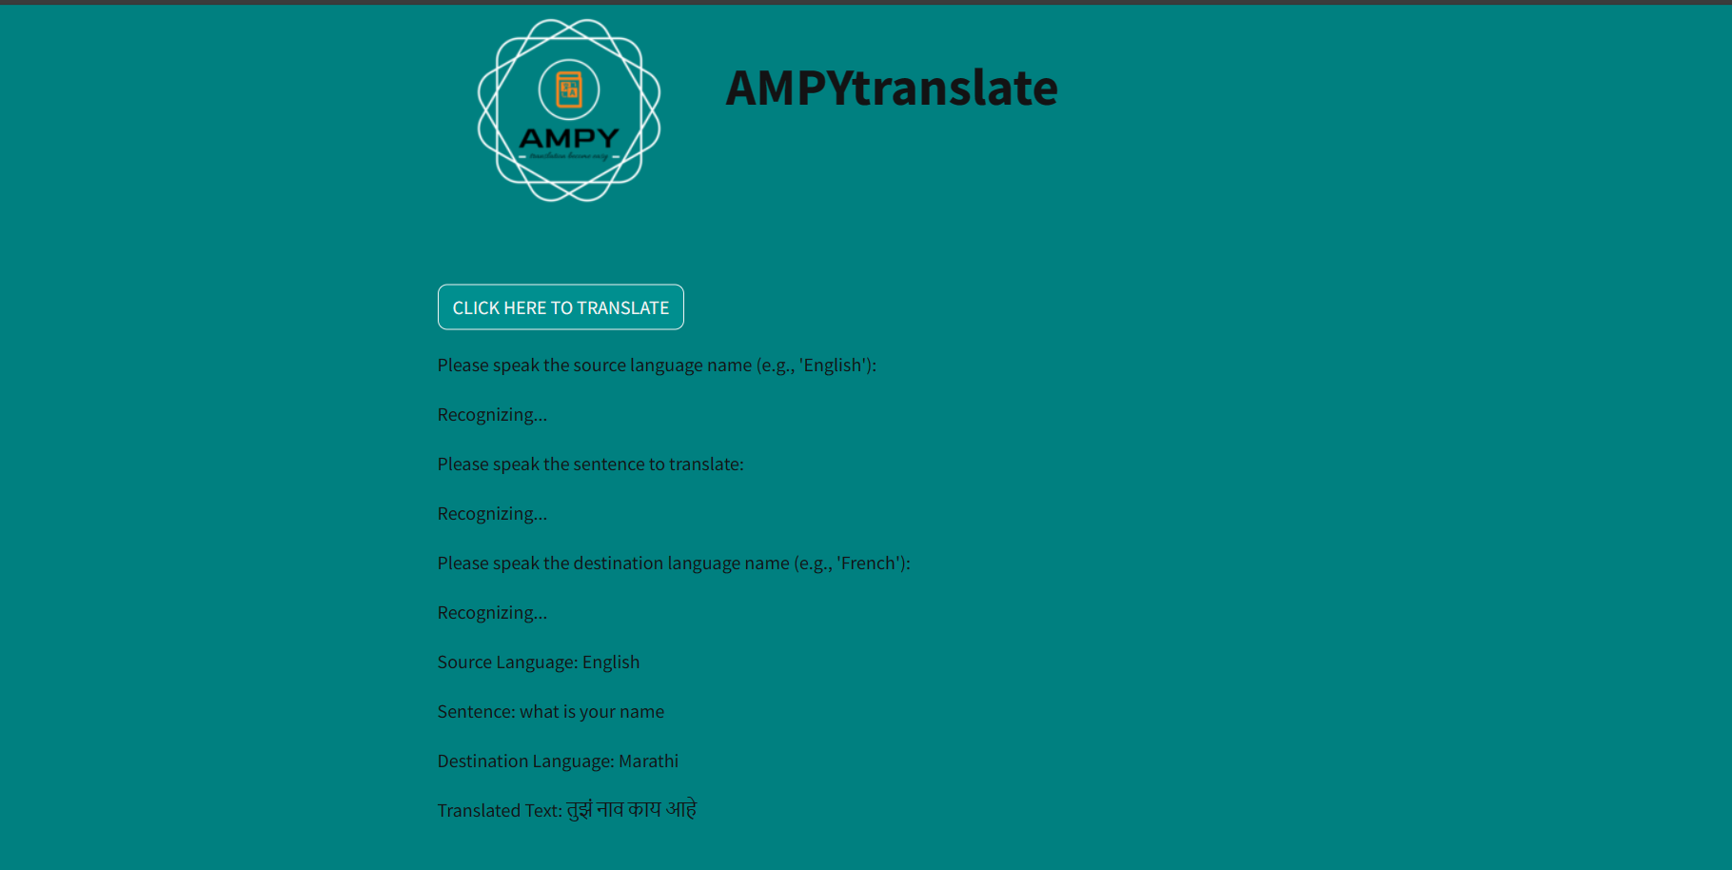

Slide 16
CONCLUSION
The app translates English speech into a different language of the user’s choice.
User can give input in the form of speech or text.
Users can choose their desired language using the shortcut keys provided.
The output is in the form of the user’s desired language.
A text-based and a voice based output is provided by the app.

Slide 17
REFERENCES
[1] “Words echoing through time: the melody of learning with A voice translator app” article: article in pulchra lingua a journal of language study literature & linguistics · november 2022.
[2]“Speech recorder and translator using google cloud speech-to-text and translation” by J.Y. Chan and H.H. Wang 1, faculty of computer science & information technology, universiti malaysia sarawak, kota samarahan, journal of IT in asia, vol 09, 2021
[3]“Analysis of voice recognition system on translator for daily use” by yudi aryatama fonggi1*, tio oktavianus JURNAL EMACS (engineering, mathematics & computer science) vol.3 no.2 may 2021.
[4]“Investigative study towards the development of mobile language translator art” international journal of digital content technology and its applications · December 2012.

Slide 18
THANK YOU

